Slide 1
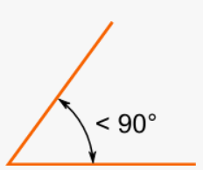
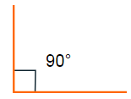
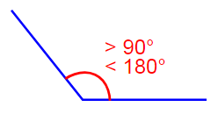
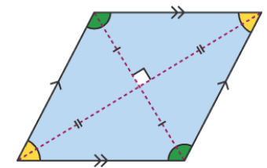
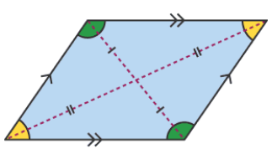
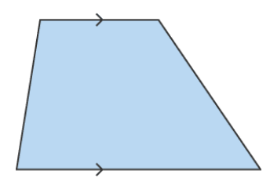
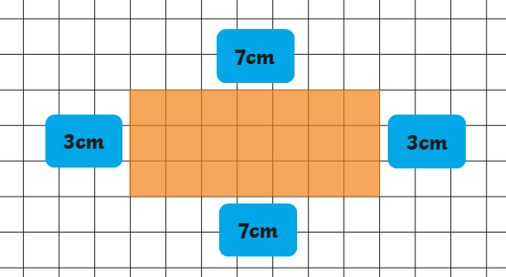
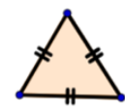
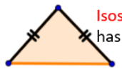

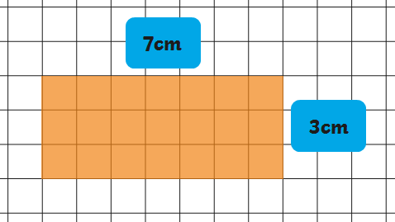

Acute angle | Right angle | Obtuse angle
Less than 90˚ | Exactly 90˚ | More than 90˚ but less than 180˚
Horizontal | Vertical
Perpendicular | Parallel
At an angle of 90 degrees | Always having the same distance between two lines
Parallelogram | Rhombus | Trapezium
Two pairs of parallel sides | All sides have the same length and are parallel | One pair of parallel sides
Length | Weight/mass | Capacity
10mm = 1cm 100cm = 1m 1,000m = 1km | 1,000g = 1kg | 1,000ml = 1l
Roman Numerals
fifty | L
One hundred | C
Five hundred | D
One thousand | M
Roman Numerals
1 | I
2 | II
3 | III
4 | IV
5 | V
6 | VI
7 | VII
8 | VIII
9 | IX
Perimeter
Perimeter is the total length of the outside of a shape.
Equilateral triangle | Isosceles triangle | Scalene triangle | Right angled triangle
3 equal sides and 3 angles of 60° | 2 equal sides and 2 equal angles | No equal sides or angles | One angle is a right angle (90°)
Area
Area is the measurement of a surface
4am | 04:00
5am | 05:00
6am | 06:00
7am | 07:00
4pm | 16:00
5pm | 17:00
6pm | 18:00
7pm | 19:00
8pm | 20:00
9pm | 21:00
10pm | 22:00
11pm | 23:00
12am | 00:00
1am | 01:00
2am | 02:00
3am | 03:00
8am | 08:00
9am | 09:00
10am | 10:00
11am | 11:00
12pm | 12:00
1pm | 13:00
2pm | 14:00
3pm | 15:00

